Slide 1
Evolution of preimplantation genetic diagnostic technologies
Alan H Handyside
The Bridge Centre, London and Illumina, Cambridge, UK

Slide 2
Disclosure
I am a part time employee of, and have share options in, Illumina, San Diego, CA, USA, based in Cambridge, UK, which manufactures equipment and reagents for DNA sequencing, diagnostics and preimplantation genetic testing

Slide 3
Overview
Brief historical overview of preimplantation genetic diagnosis and screening (PGD and PGS)
Array comparative genomic hybridisation (array CGH) and next generation sequencing (NGS) for PGS
Genome-wide single nucleotide polymorphism (SNP) genotyping for combined PGD and PGS
NGS based methods for combined mutation and marker analysis and chromosome copy number
Non-invasive preimplantation genetic testing

Slide 4
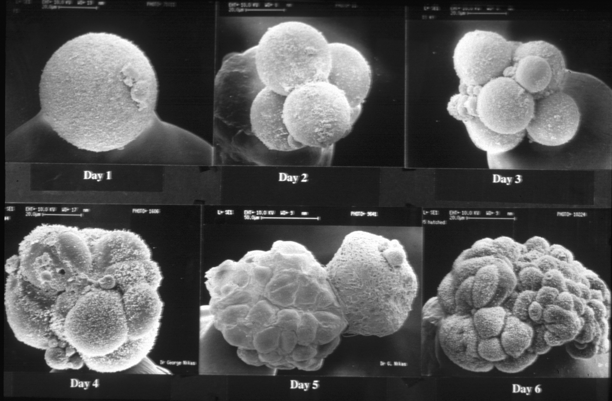
Scanning EM of human preimplantation development in vitro: Days 1 to 6 post insemination
1
2
3
4
6
6
Dr Yorgos Nikas www.aim.cat
Notes:
Surprisingly, we have discovered over the last 10-15 years that the normal cell cycle checkpoints do not seem to be operating fully following fertilisation in preimplantation embryos and that there is a high incidence of malsegregation of chromosomes during (mitotic) cleavage divisions. These beautiful SEM images of human preimplantation embryos at various stages from the single celled zygote through to hatched blastocyst ready to implant in the uterus were prepared by Dr George Nikas working with me at Hammersmith Hospital. The outer zona pellucida has been removed in each case except the lower middle panel to reveal the surface architecture of the embryo which in general on the outer surface is covered with dense microvilli.

Slide 5
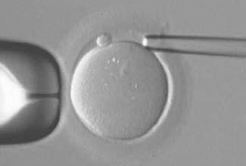
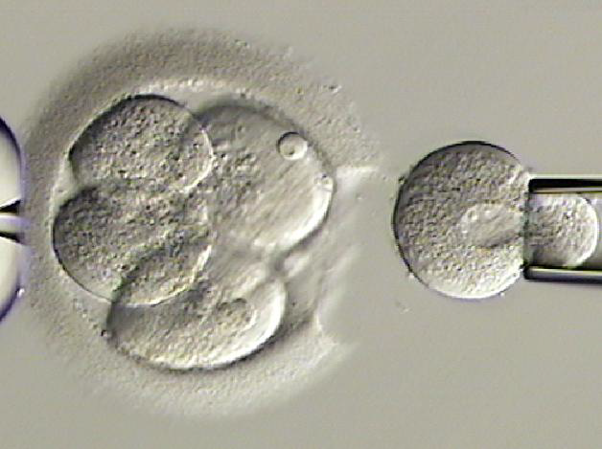
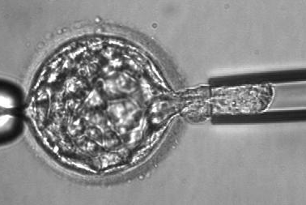
Preimplantation genetic diagnosis (PGD)
In Vitro Fertilisation (IVF)
Downregulation of ovarian folliculogenesis
Superovulation and egg collection
Intracytoplasmic sperm microinjection (ICSI) and embryo culture
Polar body, cleavage or blastocyst stage biopsy by zona drilling and micromanipulation
Single cell genetic analysis
Selective transfer of unaffected embryos

Slide 6
Some PGD indications licensed by the Human Fertilisation and Embryology Authority (HFEA) in the UK to date
Single gene defects
Duchenne muscular dystrophy
Haemophilia
Adrenoleukodystrophy
Cystic fibrosis
Spinal muscular atrophy
Beta-thalassaemia
Sickle cell disease
Tay-Sachs disease
Gaucher disease
Battens disease
Late onset
Huntington’s disease
Early onset Alzheimer’s
Cancer predispositions
Familial polyposis coli
Retinoblastoma
Li-Fraumeni syndrome
Chromosome abnormalities
Aneuploidy
Translocations
Structural
‘Saviour siblings’
HLA matching

Slide 7
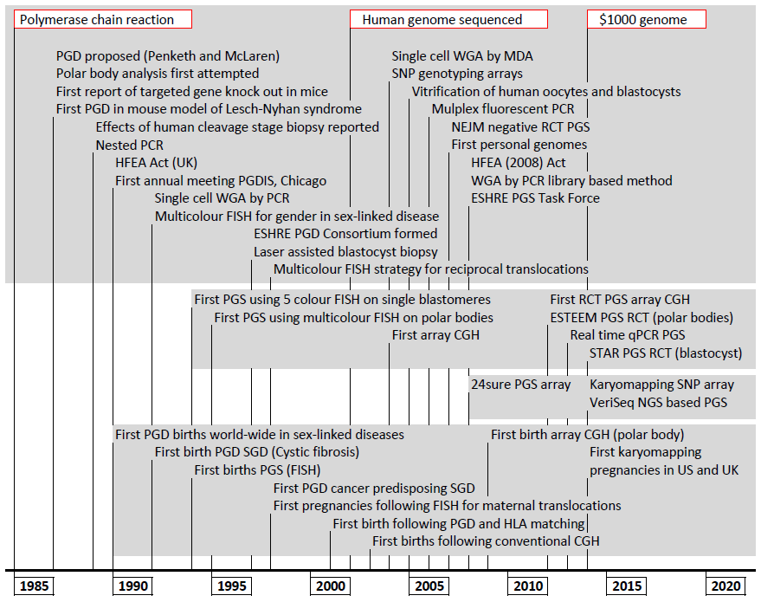

Slide 8
Evolution of PGD technologies (1)
Barr body (inactive X chromosome)
Gender selection
Karyotyping
Chromosome counting
Enzyme assays
Inherited metabolic disorders
PCR (direct/nested/duplex)
Single gene defects (SGDs)
Fluorescence in situ hybridisation (FISH)
Typically 7-9 chromosome screening
Multiplex fluorescence PCR
Targeted haplotyping ± mutation detection
Limited chromosome screening (13, 18, 21)

Slide 9
Evolution of PGD technologies (2)
Array comparative genomic hybridisation (array CGH)
24 chromosome copy number
Structural chromosome imbalance
Single nucleotide polymorphism (SNP) arrays
24 chromosome copy number
Universal linkage-based testing for SGDs combined with aneuploidy detection
Quantitative PCR
24 chromosome copy number
Next generation sequencing (NGS)
24 chromosome copy number
Targeted haplotyping, mutation detection and chromosome copy number

Slide 10
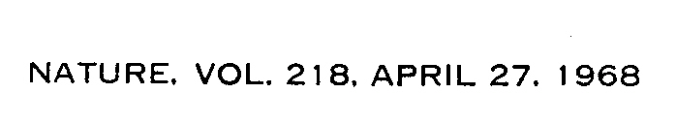
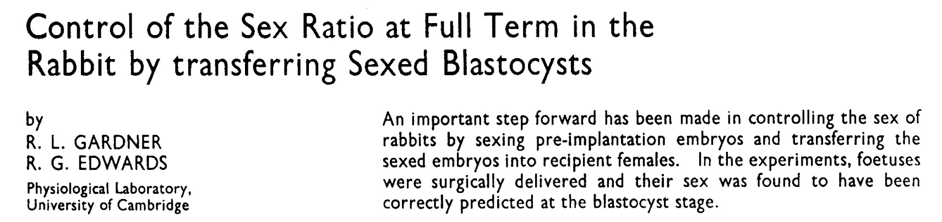
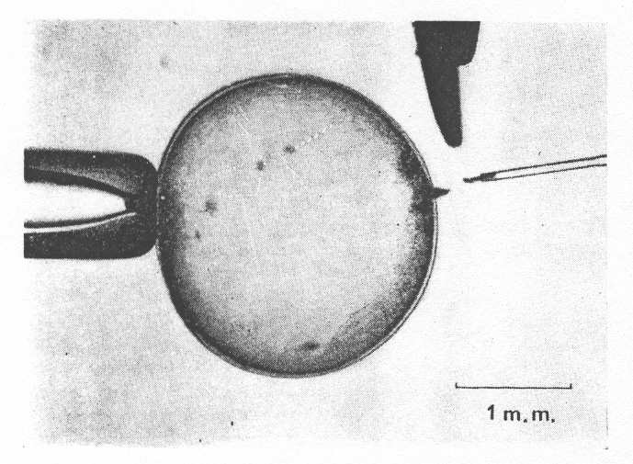
…cells excised from blastocysts could be examined for several characters, for example, chromosomes and enzymes, to detect autosomally inherited deformities from either parent…
One of the offspring was acephalic…

Slide 11
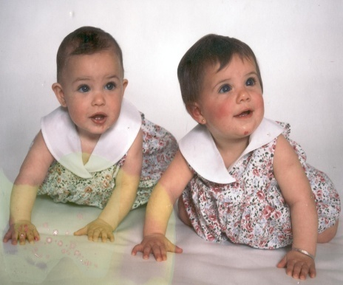
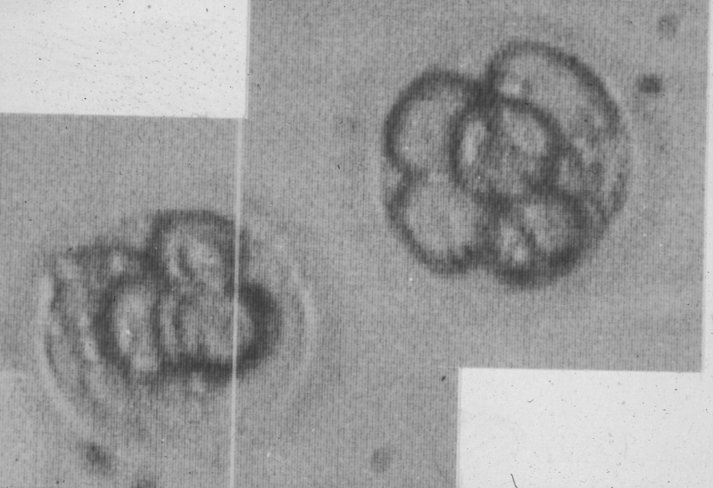
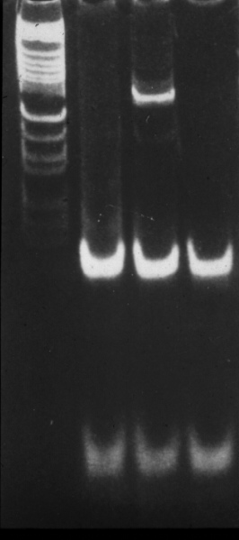
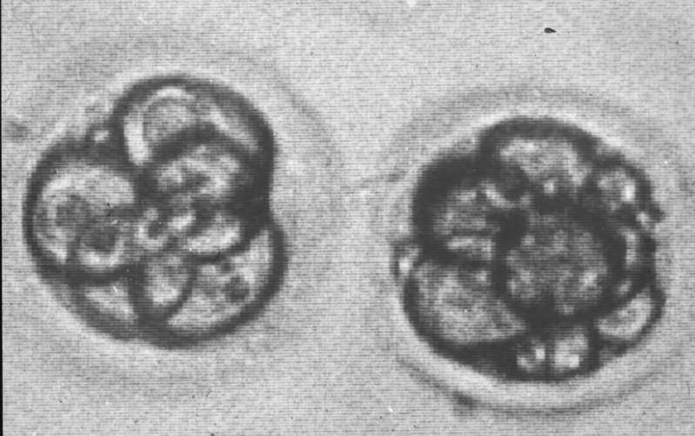
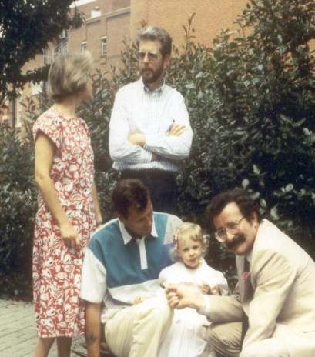
First live births following preimplantation genetic diagnosis (PGD) in July, 1990
Gender identification and selective transfer of unaffected female embryos in X-linked disease
27th birthday!
Handyside et al (1990) Nature 344, 768

Slide 12
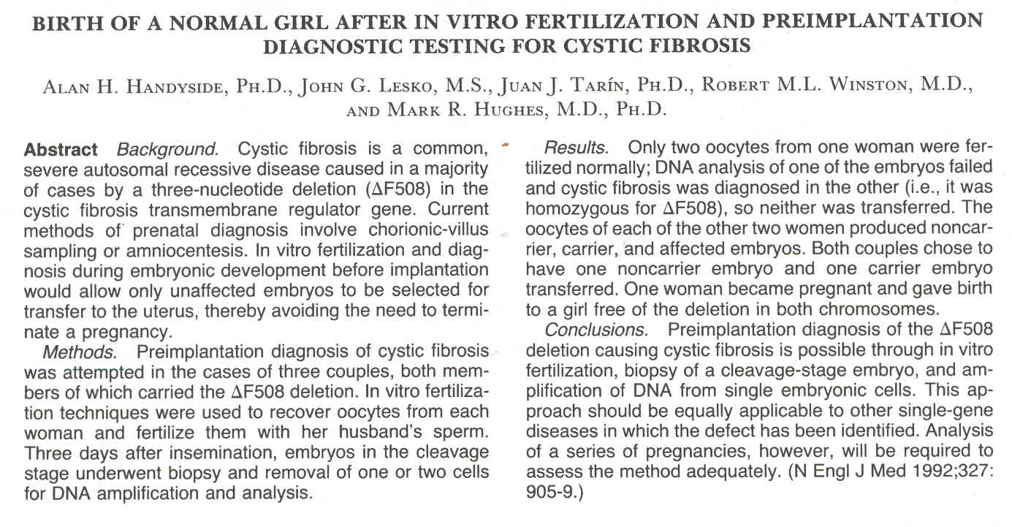

Handyside et al (1992) NEJM 327, 905-909

Slide 13
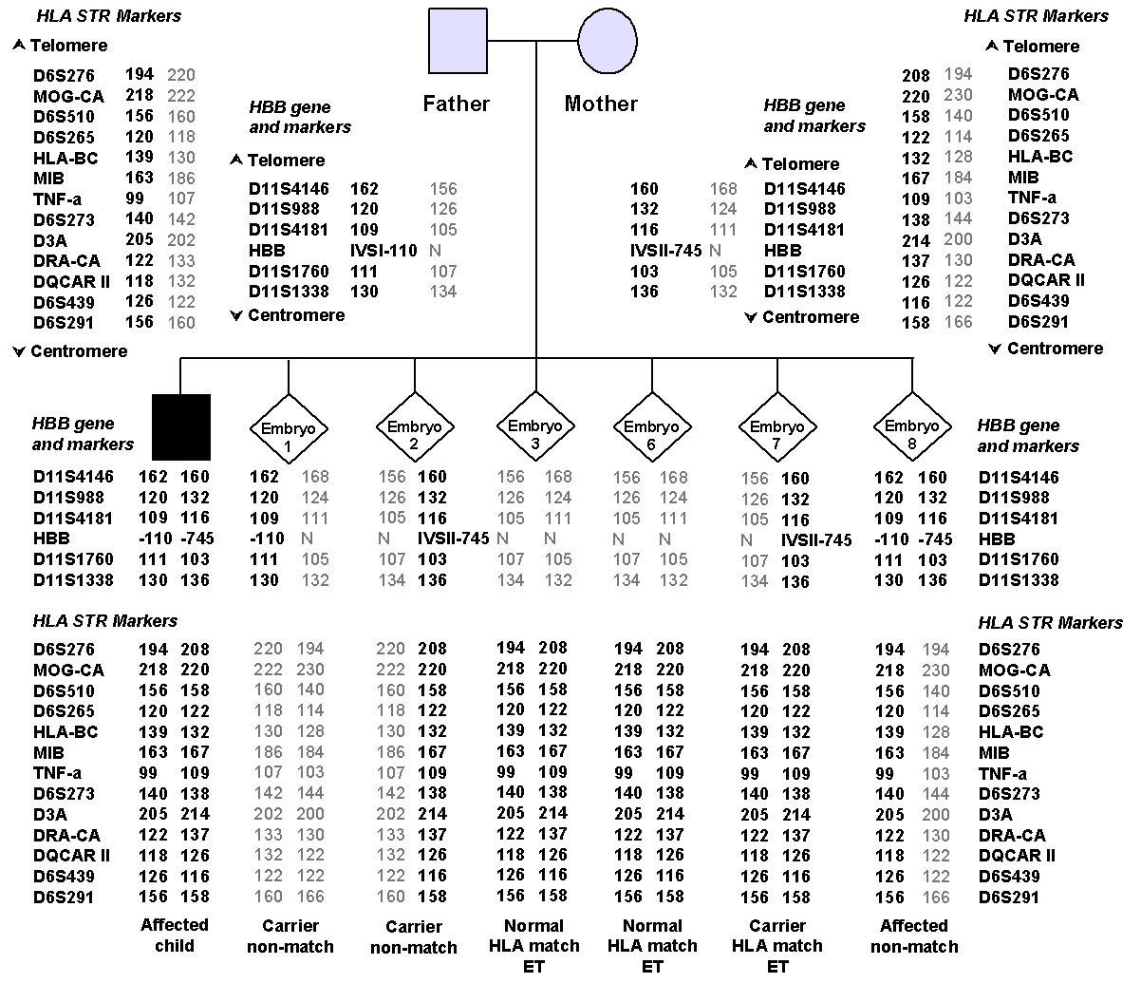
Fiorentino et al (2005) Eur J Hum Genet 13, 953

Slide 14
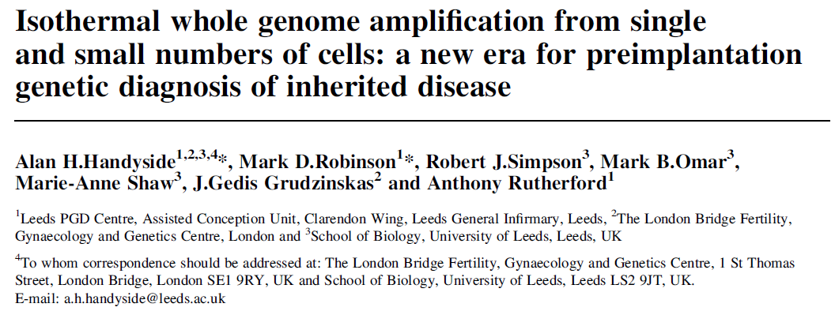
2003
Handyside et al (2004) Mol Hum Reprod 10, 762

Slide 15
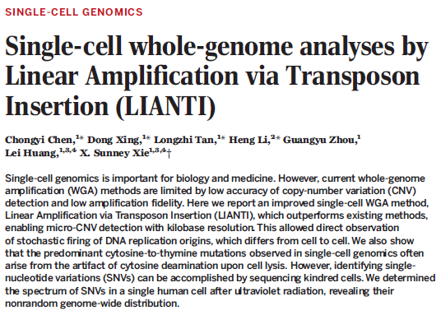
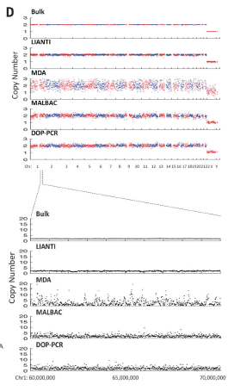
Chen et al (2017) Science 356, 189

Slide 16
Single cell genomics
Single cell (or 3-10 cells)
~ pg DNA
Whole genome amplification (WGA)
>ug DNA
PGD
SNP genotyping arrays
and karyomapping
PGS
BAC arrays for Array CGH
Low read depth NGS
NGS based solutions for combined PGD and PGS

Slide 17
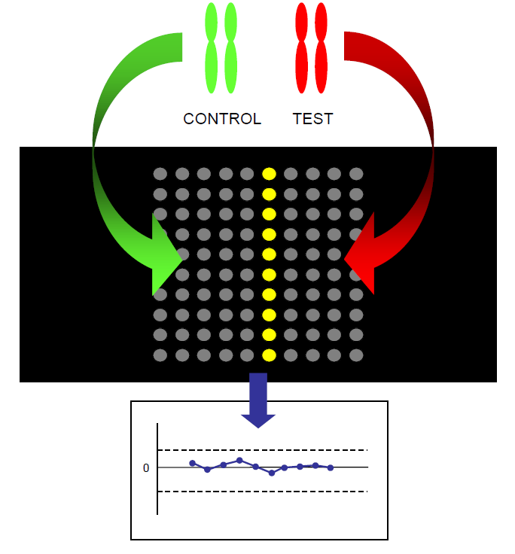
24 chromosome copy number analysis by array comparative genomic hybridisation (array CGH)

Slide 18
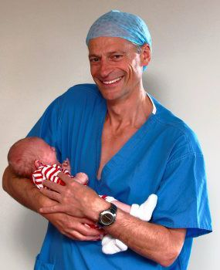

September 2, 2009
New IVF test–Array CGH
Produces baby Oliver, offering hope to infertile
13 previous failed IVF cycles
7/9 first polar bodies aneuploid

Slide 19
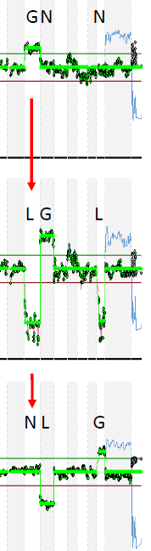
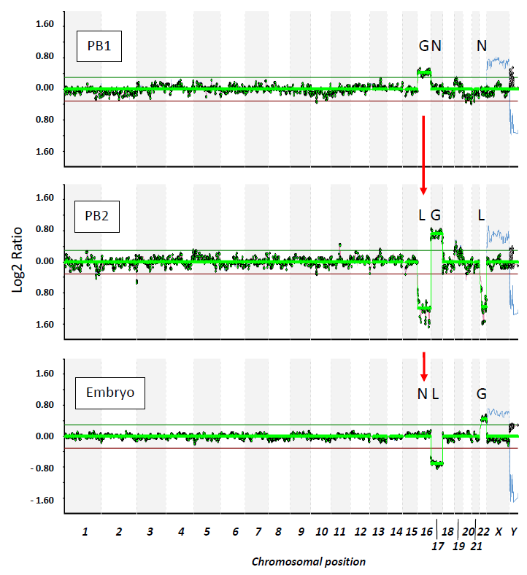

Polar Body Biopsy With Follow Up at Cleavage Stages on Day 3
Christopikou et al. (2013) Hum Reprod 28, 1426

Slide 20
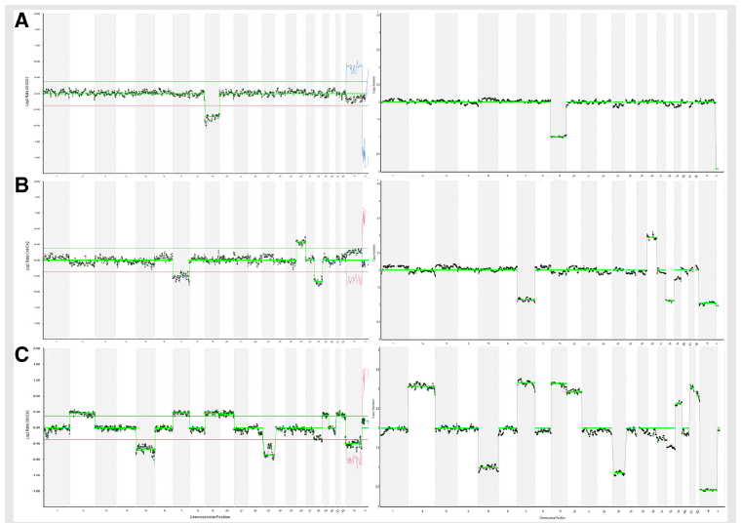
Samples analysed by array CGH and NGS highly concordant
Array CGH NGS
Fiorentino et al. (2014) Fertility and Sterility 101, 1375
Fiorentino et al. (2014) Human Reprod 29, 2802

Slide 21
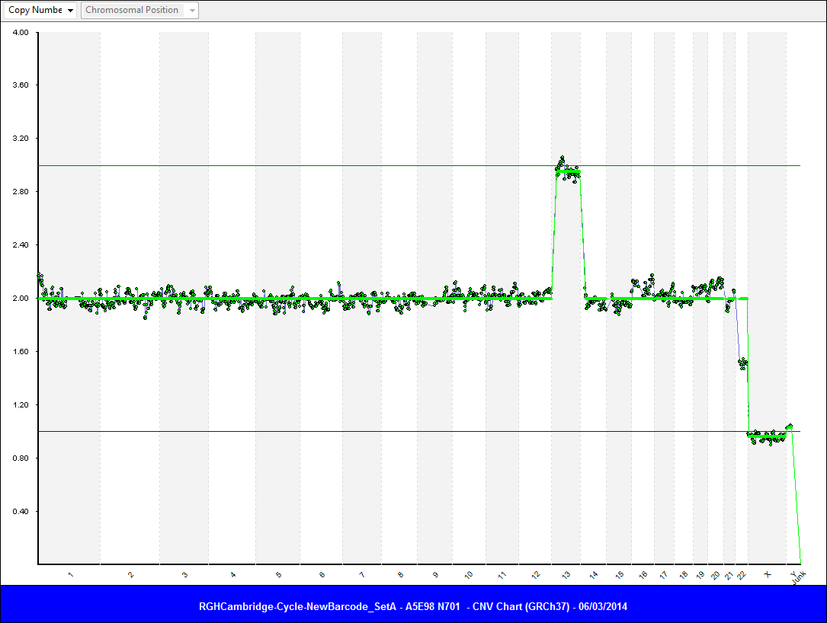
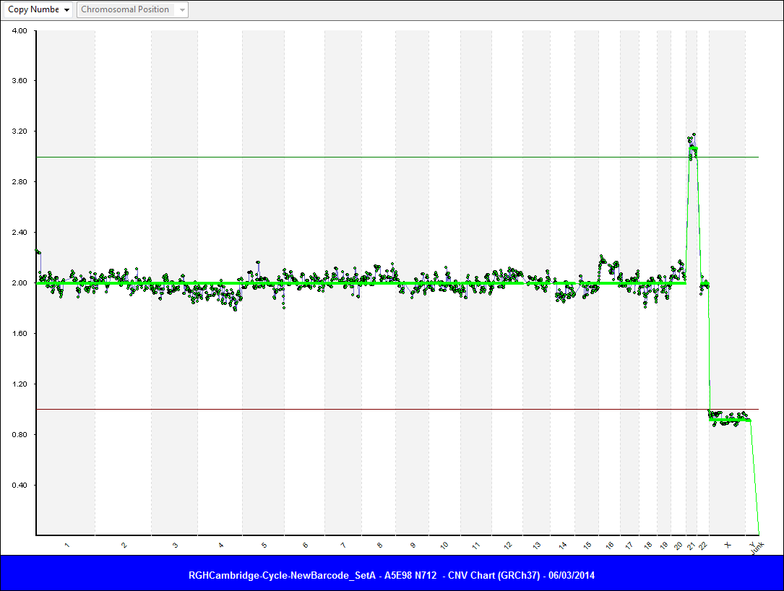
Trisomy 13
Trisomy 21
Trisomy 13
3
2
1
Increased ratio change as relationship between mapped fragment counts
and copy number is linear

Slide 22
Genome-wide single nucleotide polymorphism (SNP) genotyping for combined PGD and PGS
High density, genome-wide SNP genotyping of the parents, a close relative of known disease status to establish phase and single or small numbers of cells biopsied from each embryo following whole genome amplification
Linkage-based analysis of single gene defects combined with detection of chromosomal abnormalities

Slide 23
Clinical applications
Combined aneuploidy screening and single gene defect linkage analysis with or without mutation detection for de novo mutations
Linkage based analysis in absence of known mutation
HLA matching with or without mutation detection (including detection of crossovers in existing sick child)
Multiple disease locus analysis
Detection of structural chromosome imbalance at high resolution (including identification of normal or balanced carriers)

Slide 24
10K SNP analysis following MDA
2004
 | Gender | SNP Call | Signal Detection | AA | AB | BB
gDNA | Male | 97.44% | 99.54% | 33.08% | 33.15% | 33.77%
1 cell | Male | 52.65% | 60.95% | 47.47% | 5.10% | 47.43%
5 cell | Male | 84.14% | 95.81% | 42.50% | 14.05% | 43.45%
Chromosome 6 (SNPs 693)
 | gDNA | 1 cell | 5 cells
AA | 216 (31) | 181 (26) | 232 (33)
AB | 215 (31) | 119 (17) | 88 (13)
BB | 243 (35) | 67 (10) | 276 (40)
No call | 19 (3) | 326 (47) | 97 (14)
Handyside and Robinson (2004) unpublished

Slide 25
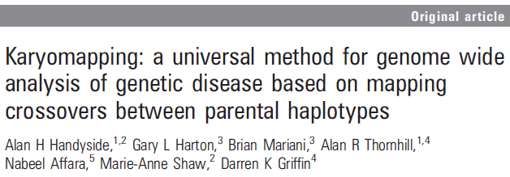
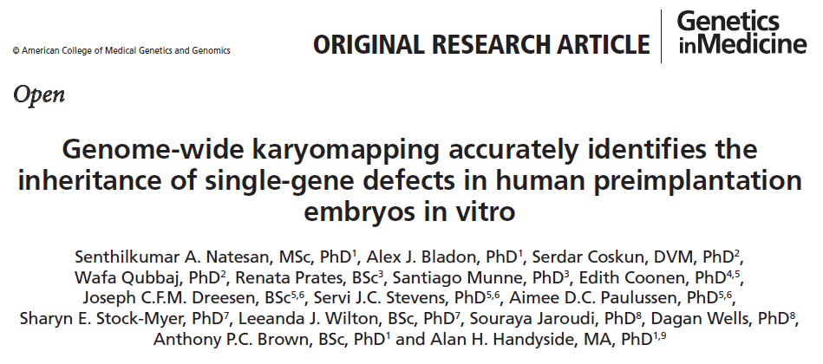
Handyside et al (2010) J Med Genet 47, 651-658
Natesan et al. (2014) Genetics in Medicine 16, 838

Slide 26
Informative Key SNPs and Non-Key SNPs
Informative Parent | Father | Mother | Embryo
Informative SNPs for Father | AB | AA | AB = Key BB = Key AA = Non-Key
 | AB | BB | AB = Key AA = Key BB = Non-Key
Informative SNPs for Mother | AA | AB | AB = Key BB = Key AA = Non-key
 | BB | AB | AB = Key AA = Key BB = Non-key

Slide 27
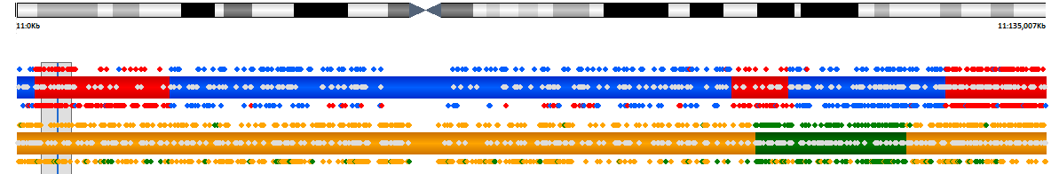
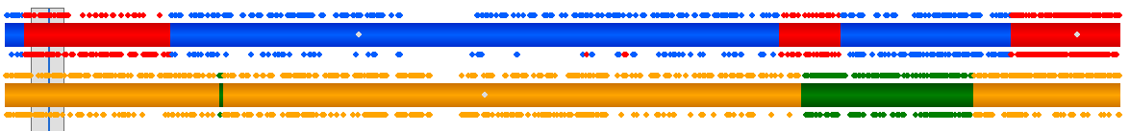
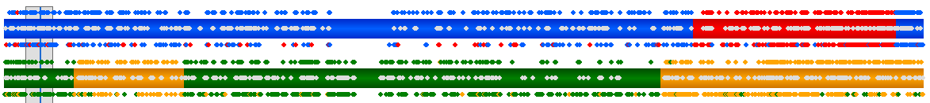
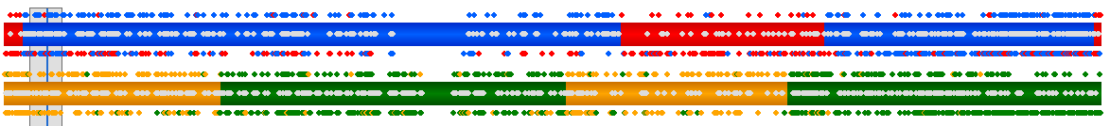
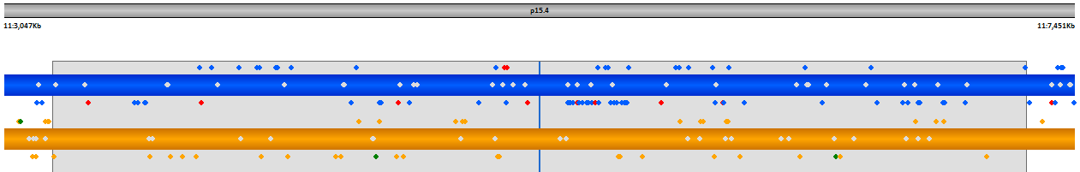
PGD of Beta Thalassaemia by Karyomapping
(a)
Chr 11 (0 – 135,007Kb)
Paternal chromosome
Child
Maternal chromosome
Paternal SNP markers
Embryo 1
Maternal SNP markers
Embryo 2
Embryo 3
Beta globin gene on chr 11
HBB
(b)
Karyomapping provides thousands of informative markers across each chromosome in a single universal assay for single gene defects
Chr 11p15.4 (3,047 – 7,451Kb)
Embryo 3
Molecular genetic ‘chromosome painting’
HBB

Slide 28
PGD condition | Mode of inheritance | Gene/Locus | Phenotype MIM number | Chr | Region | SNP coverage
 |  |  |  |  |  | 5' | Gene/ Locus | 3'
Crigler Najar Syndrome | AR | UGTIA1 | 218800 | 2 | 234,668,918-234,681,944 | 261 | 2 | 372
Bardet Biedl Syndrome 3 | AR | ARL6 | 209900 | 3 | 97,483,594-97,517,372 | 280 | 6 | 212
Huntington Disease | AD | HTT | 143100 | 4 | 3,076,407-3,245,686 | 315 | 14 | 256
Facioscapulohumeral muscular dystrophy | AD | FSHD | 158900 |  | 183,200,000-191,154,276 | 291 | 853 | 0
Spinal Muscular Atrophy | AR | SMN1 | 253300 | 5 | 70,220,767-70,248,838 | 29 | 7 | 98
Osteopetrosis-infantile Malignant | AR | OSTM1 | 259720 | 6 | 108,362,612-108,395,940 | 221 | 7 | 113
Polycystic Kidney Disease | AR | PKHD1 | 263200 | 6 | 51,480,144-51,952,422 | 274 | 78 | 342
Cystic Fibrosis | AR | CFTR | 219700 | 7 | 117,120,016-117,308,718 | 93 | 34 | 55
Congenetial Lipodystrophy type 1 | AR | AGPAT2 | 608594 | 9 | 139,567,594-139,581,910 | 304 | 2 | 211
Beta-thalassemia | AR | HBB | 613985 | 11 | 5,246,695-5,248,300 | 201 | 14 | 305
Sickle cell Anemia | AR | HBB | 603903 | 11 | 5,246,695-5,248,300 | 201 | 14 | 305
Smith Lemli Optiz | AR | DHCR7 | 270400 | 11 | 71,145,456-71,159,476 | 213 | 4 | 277
Breast cancer predisposition (BRCA2) | AD | BRCA2 | 612555 | 13 | 32,889,616-32,973,808 | 207 | 7 | 151
Retinoblastoma | AD | RB1 | 180200 | 13 | 48,877,883-49,056,026 | 294 | 14 | 195
Propinic Acedimuia | AR | Alpha PCCA | 606054 | 13 | 100,741,268-101,182,690 | 299 | 46 | 258
Li-Fraumeni syndrome | AD | TP53 | 151623 | 17 | 7,571,719-7,590,867 | 250 | 2 | 283
Breast Cancer 1 | AD | BRCA1 | 604370 | 17 | 41,196,311-41,277,499 | 156 | 25 | 340
Peutz-Jeghers syndrome | AD | STK11 (LKB1) | 175200 | 19 | 1,205,797-1,228,433 | 137 | 4 | 307
Familial hypercholesterolemia | AD | LDLR | 143890 | 19 | 11,200,037-11,244,505 | 281 | 12 | 281
Myotonic dystrophy type 1 | AD | DMPK | 160900 | 19 | 46,272,974-46,285,814 | 136 | 0 | 108
Bardet Biedel Syndrome | AR | MKKS / BBS6 | 209900 | 20 | 10,385,427-10,414,886 | 324 | 3 | 274
Duchene Muscular Dystrophy | XR | DMD | 310200 | X | 31,137,344-33,357,725 | 226 | 320 | 66
Xq deletion |  |  |  | X | 131,336,145-132,612,743 | 156 | 38 | 152
Fragile-X Syndrome | XD | FMR1 | 300624 | X | 146,993,468-147,032,646 | 279 | 8 | 259
X-linked myotubular myopathy | XR | MTM1 | 310400 | X | 149,737,046-149,841,615 | 255 | 17 | 356
Incontinentia pigmenti | XD | IKBKG | 308300 | X | 153,770,458 -153,793,260 | 340 | 4 | 246
 |  |  |  |  | Range | 29-340 | 0-853 | 0-372

Slide 29
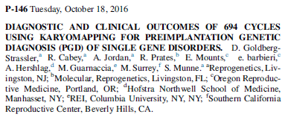
694 PGD cycles by karyomapping for 105 SGDs, HLA matching, micro deletions/duplications
Implantation and pregnancy rates (224 cycles with embryo transfer), 76% and 75% per ET (with chromosome screening)
No misdiagnoses in 121 cycles with pregnancy outcomes (including 6x CVS and 9x newborn testing all concordant with karyomapping)
Goldberg-Strassler et al (2016) Fert Stert 106 (3) Suppl e160

Slide 30
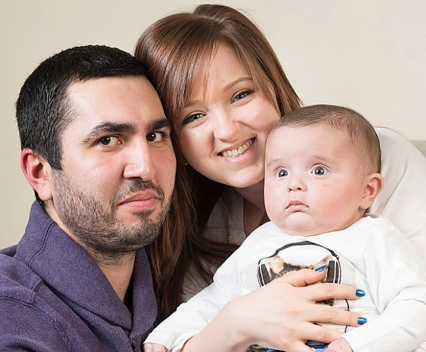
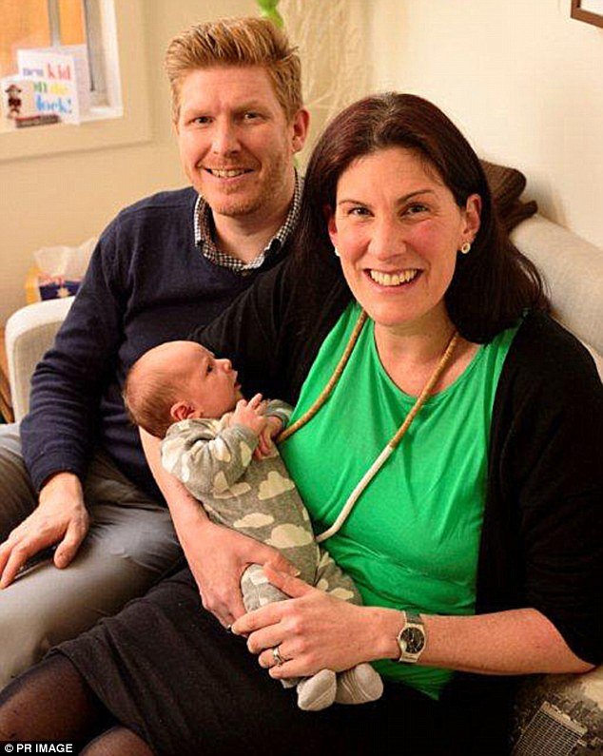
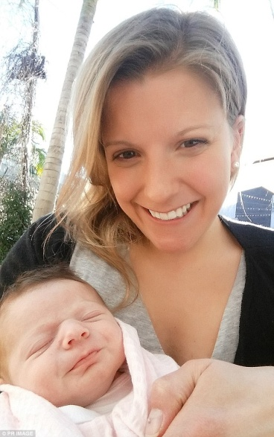
United Kingdom
Charcot-Marie-Tooth disease
Lucas born December, 2015
Australia
Congenital Myasthenic Syndrome
Benjamin
Breast cancer predisposition (BRCA1)
Sophie
Both born 17th July, 2015
China
Congenital Adrenal Hyperplasia
First birth January 2016 Shanghai Ji Ai Genetics and IVF Institute

Slide 31
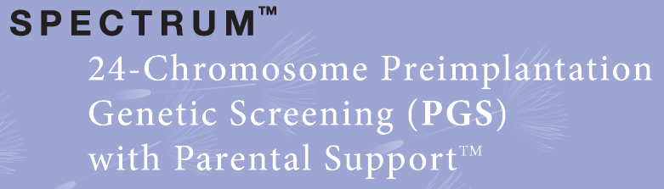


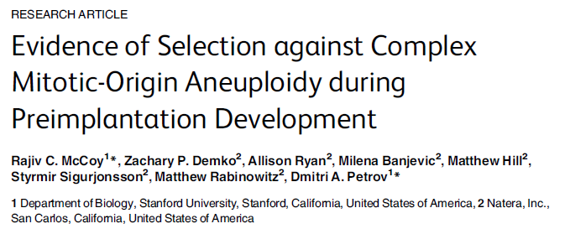
McCoy et al (2015) PLoS Genetics 11(10): e1005601

Slide 32
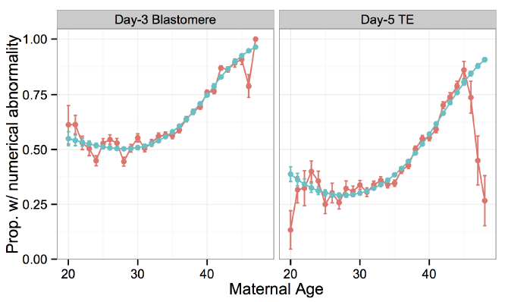
Incidence of whole chromosome aneuploidy identified by SNP genotyping and parental support (karyomap) analysis
n=28,052
n=18,387

Slide 33
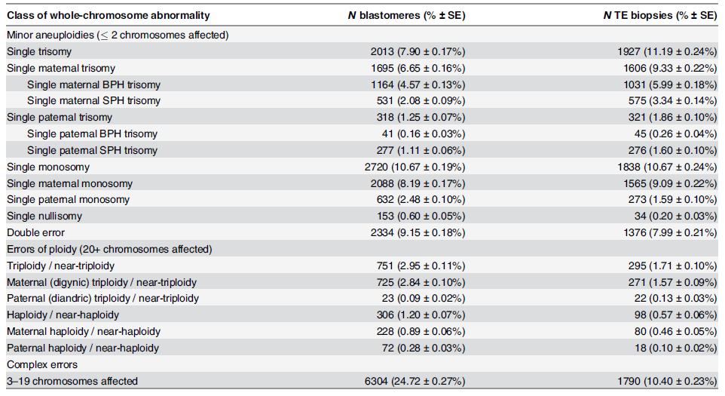

Slide 34
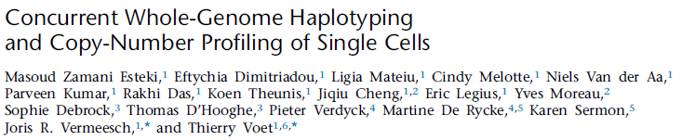
siChild and haplarithmisis analysis
Zamani Esteki et al (2015) Amer J Hum Genet 96, 894

Slide 35
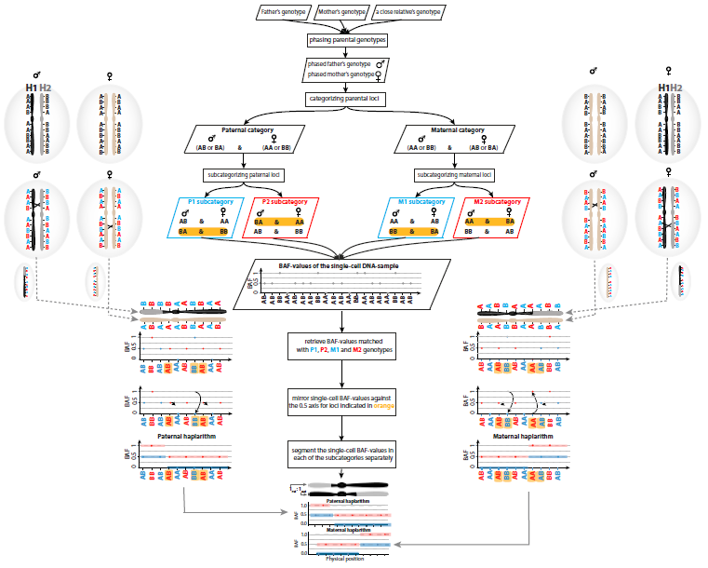
Haplarithmisis

Slide 36
Genetic feature | Karyomapping
Linkage markers | Genome-wide SNP coverage
Intragenic markers | Commonly available
Meiotic trisomy | Parent of origin and MI or MII type
Mitotic trisomy | Extended algorithms only*
Monosomy | Parent of origin
Deletions (>1-5Mb) | High resolution/parent of origin
Uniparental heterodisomy | Parent of origin
Uniparental isodisomy | Extended algorithms only*
Triploidy | Parent of origin
Tetraploidy | Not detected
Single Nucleotide Variants | Not detected
Consanguinity | Informative unless all chr shared
Paternity testing | Highly informative
Chromosome/embryo fingerprint | Unique pattern of recombination events
Contamination | Detected

Slide 37
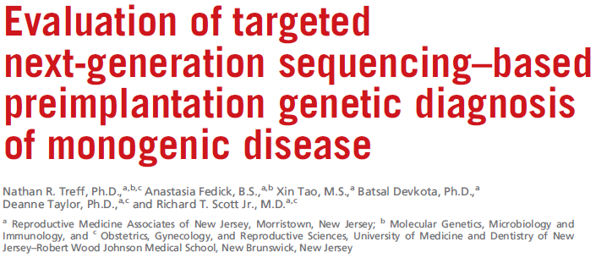
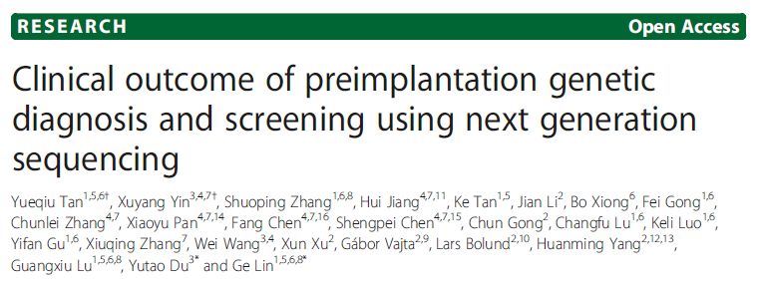
PGD and PGS for chromosome aneuploidy
using next generation sequencing (NGS)
Treff et al (2013) Fertility and Sterility 99, 1377
Tan et al (2014) GigaScience 3, 30

Slide 38
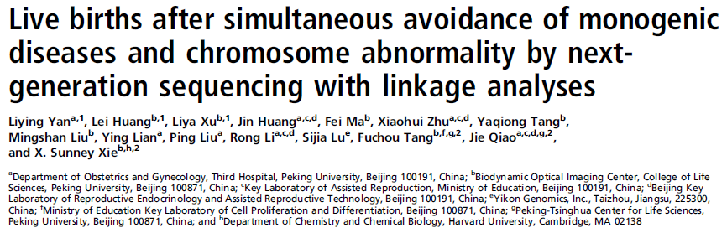
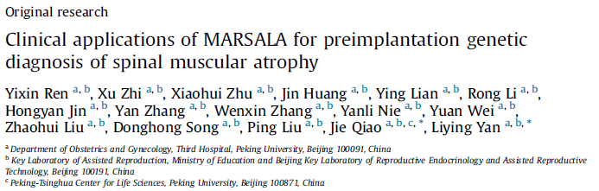
Yan et al (2015) PNAS 112, 15964
Ren et al (2016) J Genet Genom 43, 541

Slide 39
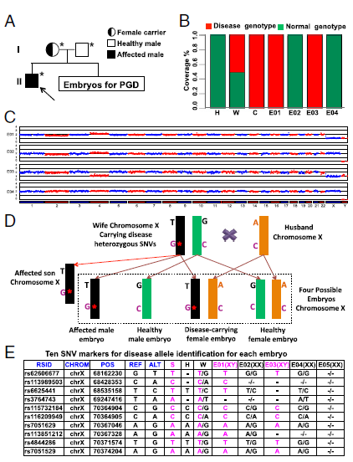
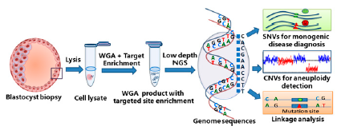
Mutated allele revealed by sequencing with aneuploidy and linkage analyses (MARSALA)
Yan et al (2015) PNAS 112, 15964

Slide 40
Pros and cons of SNP genotyping and karyomapping and NGS for PGD and chromosomal screening
Targetted sequencing by SNP genotyping and karyomapping provides a single universal test for PGD by linkage and detection of major chromosome abnormalities
Low cost and automated software
Can be combined with mutation detection by minisequencing, for example, if necessary, and also NGS based chromosome copy number analysis
NGS based methods have the potential to combine all these features in addition to mutation analysis
Labour intensive and higher cost
Potential for detection of variants of unknown significance (VOUS) at the sequence level

Slide 41
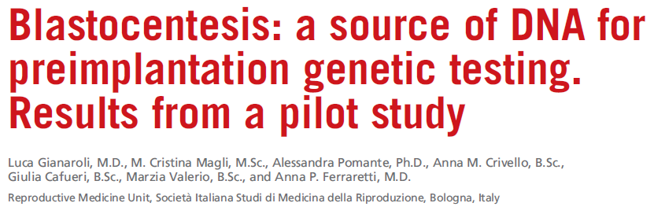
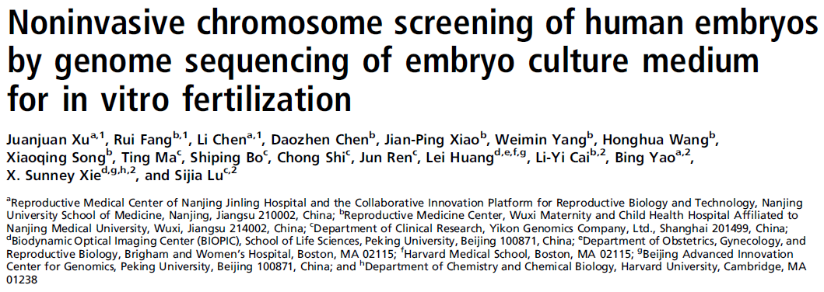
Non-invasive preimplantation genetic testing (NIPGT) by blastocentesis or analysis of embryo culture medium
Gianaroli et al (2014) Fert Stert 102, 1692
Xu et al (2016) PNAS 113, 11907

Slide 42



Slide 43
Non-invasive preimplantation genetic testing (NIPGT):
a dream or reality?
Cell free DNA (cfDNA) detected in blastocoel fluid (blastocentesis) and spent culture medium
Whole genome amplification and chromosome copy number analysis concordant with trophectoderm biopsy samples in most but not all samples
Source of cfDNA may be detached, dying or dead cells
No guarantee that the cfDNA is representative or exceeds 1x genome equivalent
Culture medium sometimes contaminated
Possible advantages of NIPGT outweighed by lower efficiency
cfDNA in blastocoel fluid may be more representative of the inner cell mass
Handyside (2016) Fert Stert Sep 16 doi: 10.1016

